Slide 1
SCCL ML Ops Idea
July 2021

Slide 2



SCCL Introduction
Background Information
Manage the sourcing, delivery and supply of healthcare products, services and food for NHS trusts and healthcare organisations across England and Wales.
Manage more than 4.5 million orders per year, across 94,000 order points and 15,000 locations.
Target to deliver savings of £2.4 billion by 2023/24, to be reinvested into frontline services.
Owned by the Secretary of State for Health and Social Care.
Customer Name
NHS Supply Chain Coordination Limited
(SCCL)
Location
UK
Industry
Public Sector
Services
Consulting
Website
https://www.sccl.nhs.uk/

Slide 3
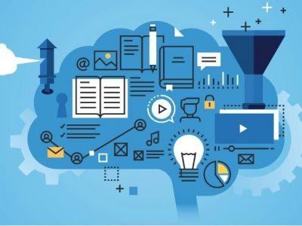
Opportunity
Aim
SCCL’s aim is to aim is to realise savings for our customers and drive operational efficiencies.
Objective
To aid SCCL in delivering its target of cutting costs for the NHS
Solution
Implement an ML Ops solution
The goal of MLOps is to extract business value from data by efficiently operationalising ML models at scale
Target the Category Towers systems
Predicting the amount of products/services to be purchased during a defined future period
Potentially tie it into Home Delivery system
Notes:
CT support the NHS to plan and procure medical equipment, consumables and specialist services by offering a range of compliant framework agreements, managed services and aggregation initiatives.

Slide 4
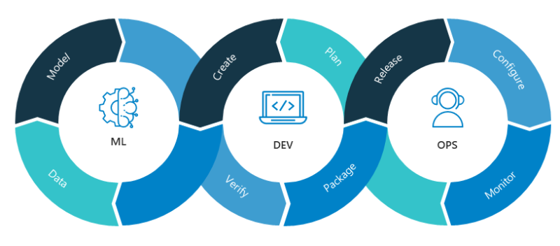
Why ML Ops?
Compared to traditional demand forecasting methods, machine learning:
Accelerates data processing speed
Provides a more accurate forecast
Automates forecast updates based on the recent data
Analyses more data
Identifies hidden patterns in data
Creates a robust system
Increases adaptability to changes
Notes:
Machine learning techniques allow predicting the amount of products/services to be purchased during a defined future period.
In this case, a software system can learn from data for improved analysis.

Slide 5

Data
The databases for the Category Towers and Home Delivery Service systems are Oracle and SQL
Oracle has a very limited ML Ops opportunities
A lot of the data that SCCL handles contains Personal Identifiable Information and Personal Health Information
Protected under GDPR laws
This implies that trying to use solutions like AWS/Azure would be impractical due to security concerns

Slide 6
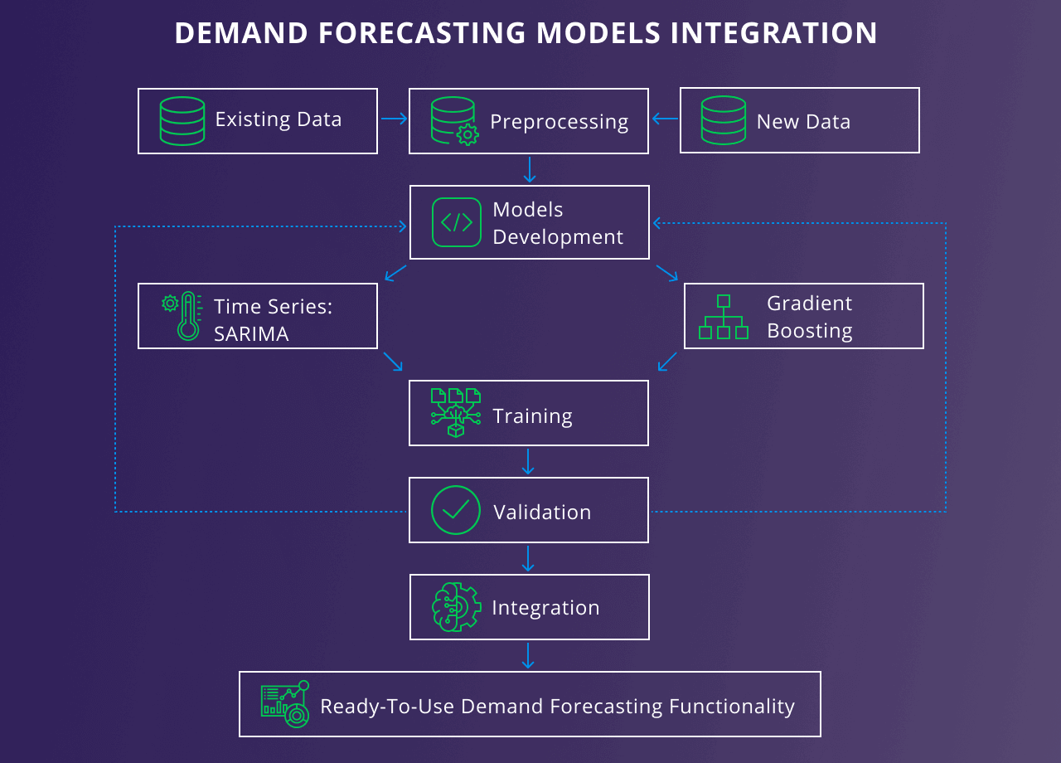
Delivery
Create a custom solution for SCCL from scratch
Develop the model using tools like Jupyter and Visual Studio Code
Build the model using frameworks like Pytorch, TensorFlow and Scikit-Learn
Use pre existing solutions to aid in model creation, e.g. AWS, Azure
Demand forecasting
Quantitative Approach
Trend Projection
Time Series Modelling
Notes:
Demand forecasting features optimize supply chains. This means that at the time of order, the product will be more likely to be in stock, and unsold goods won’t occupy prime retail space.
Due to the type of SCCL Databases and the type of data held in them, it’s worthwhile creating from scratch.
Will you design your ML pipeline to operate on-premise, in the cloud, or in a hybrid environment?
How will customers use your ML pipeline?
Will your ML pipeline operate on data batches, streaming data, or be event-driven?
How will you monitor the reliability and reproducibility of your ML pipeline?

Slide 8
SCCL Key Challenges
Lack of Management and Data Security
Risk of fines costing up to 4% of total revenue due to regulatory non-compliance
Savings analysts find it hard to manage data spread across multiple systems
Effort Spent Extracting and Cleaning Data
Up to 80% of Savings analysts time is spent extracting and cleaning data
83% of Savings analysts believe that these problems directly caused Savings reports and month-end processes to be delayed
Inaccurate Savings Reports
Savings reports contain data errors and incomplete data
73% of Savings analysts don’t trust the accuracy of reporting
59% of Savings analysts have experienced unusable data
Data Quality Issues are Increasing
Data quality errors are entering the system faster than they can be fixed
Datasets are growing and as data quality issues go untreated, month by month the overall quality of reporting decreases

